Slide 1
Solving CTF Python
Name:
ca

Slide 2


Slide 3
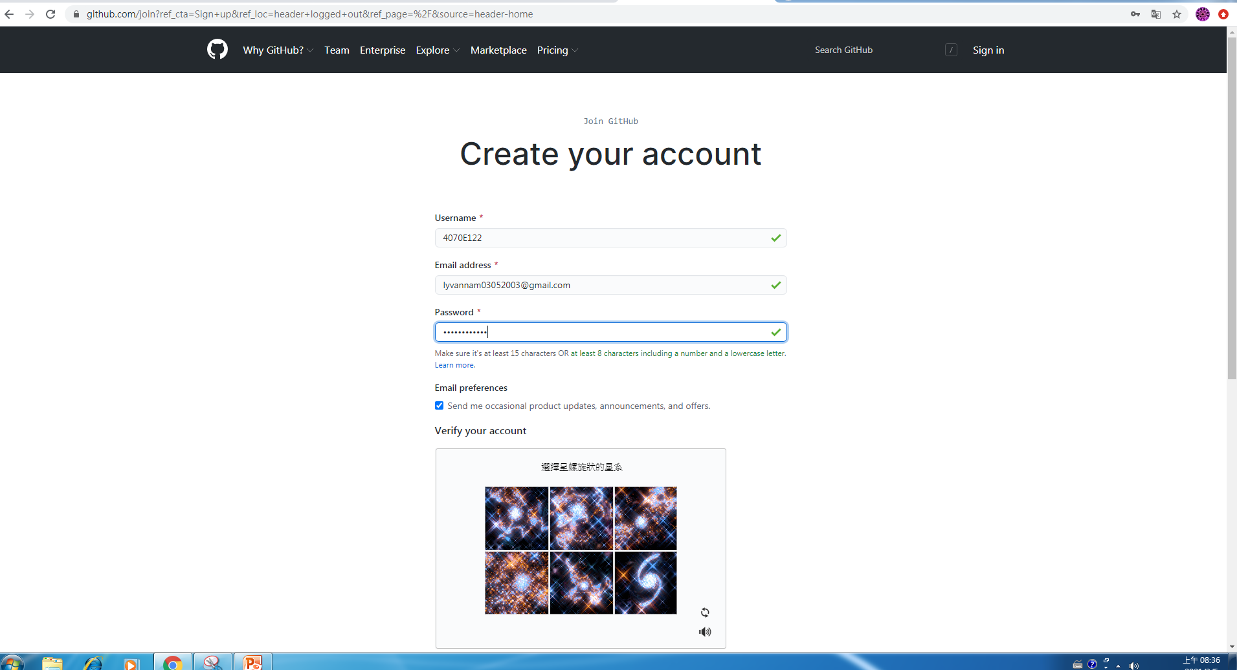

Slide 4
http://github.com/mydeargreatteacher
mydeargreatteache

Slide 5
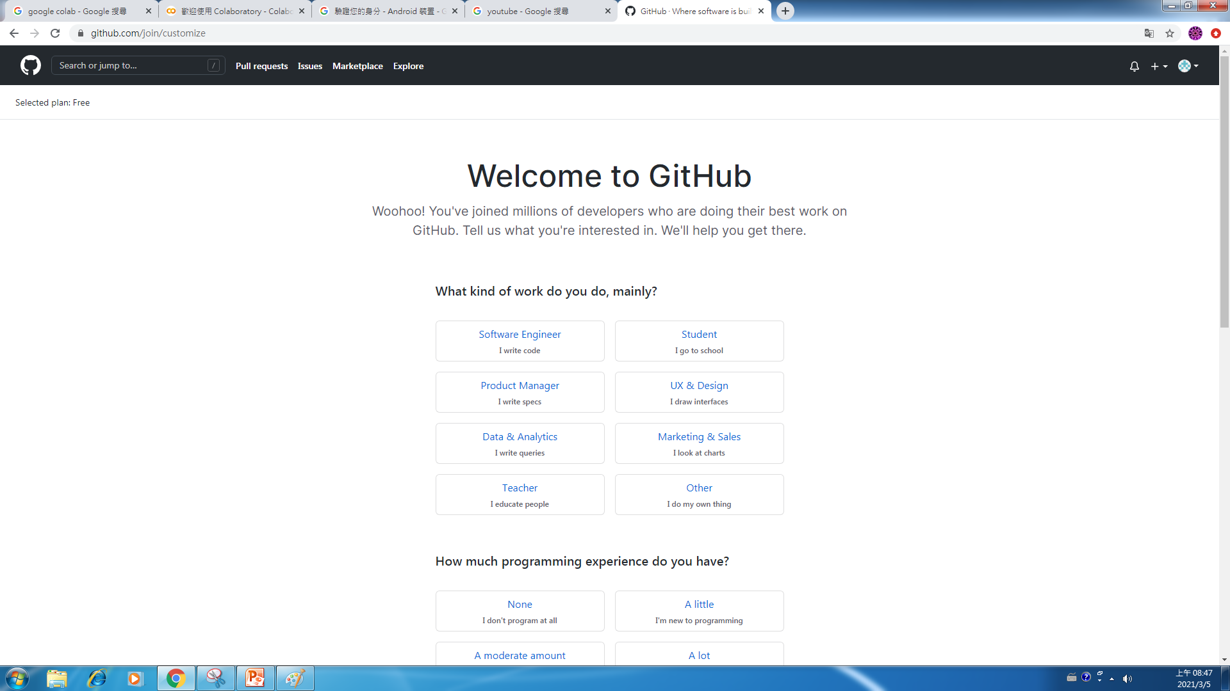

Slide 6
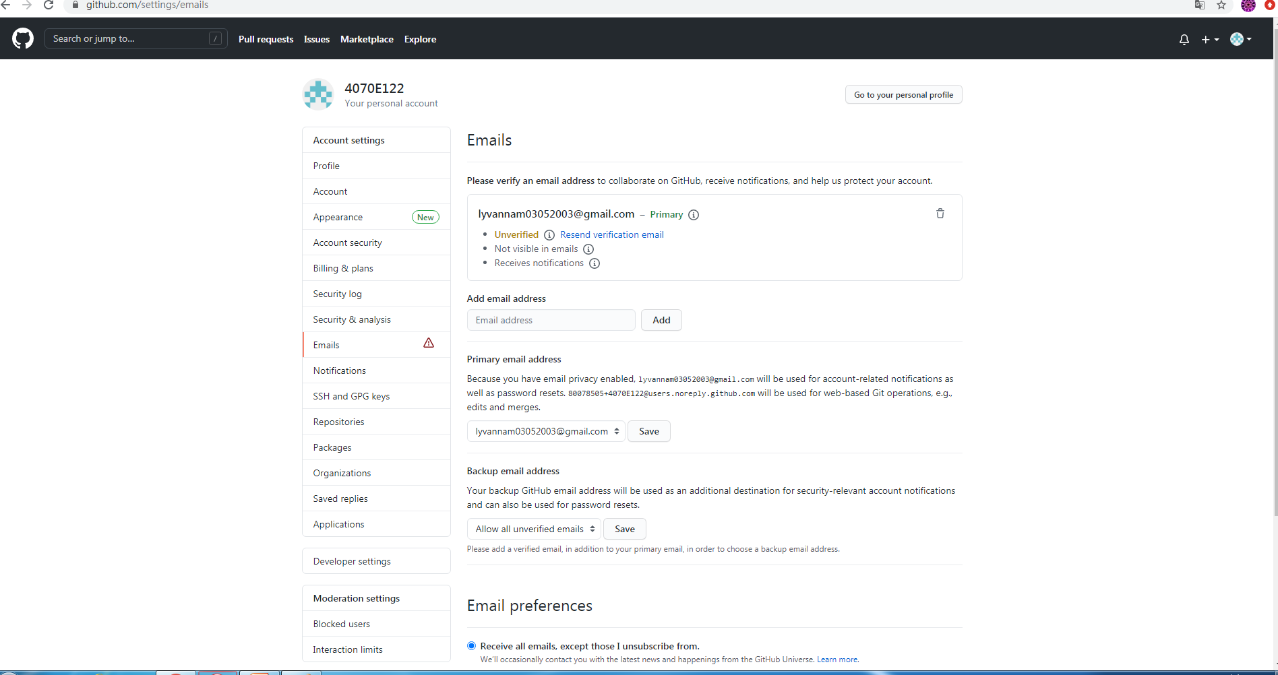

Slide 7
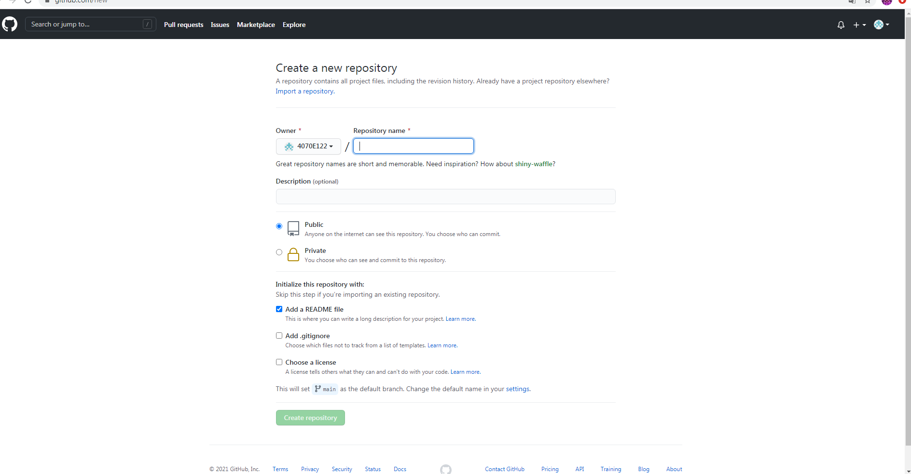

Slide 8
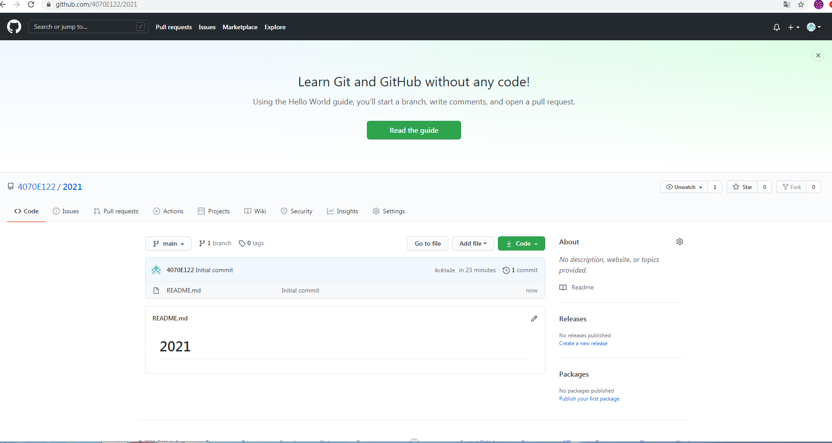

Slide 9
